Slide 1


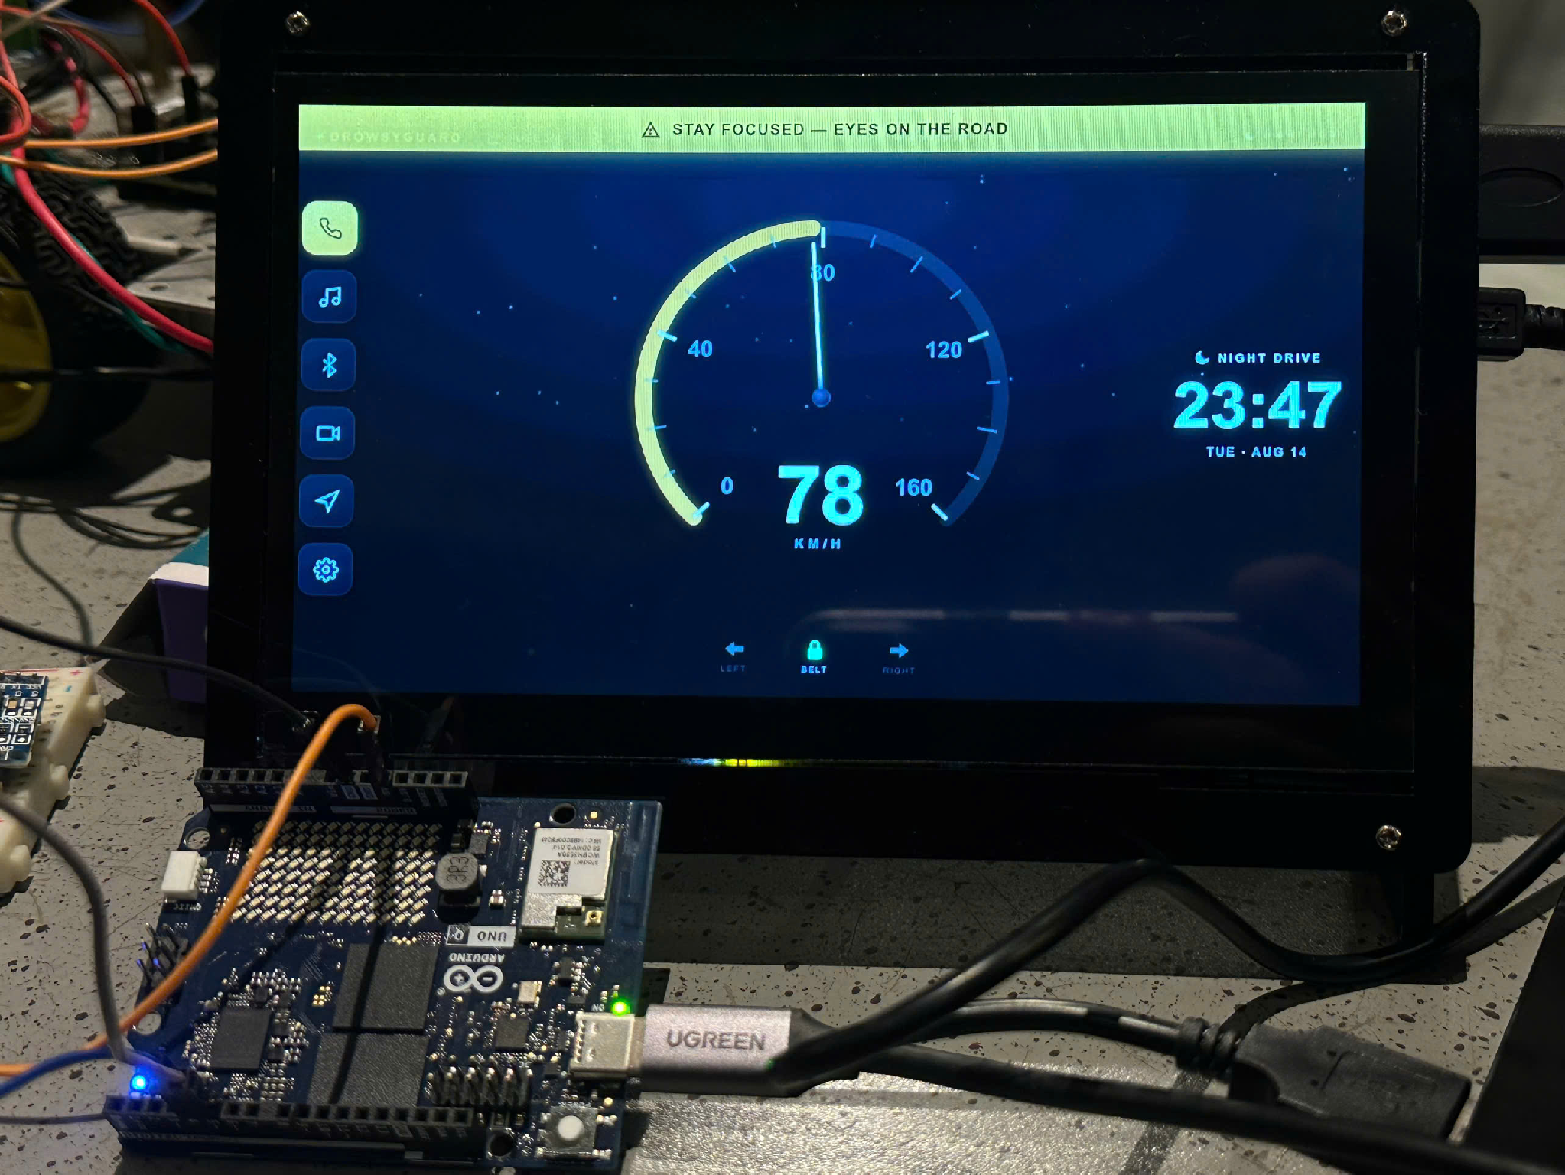
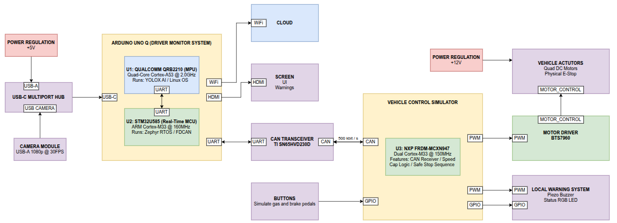
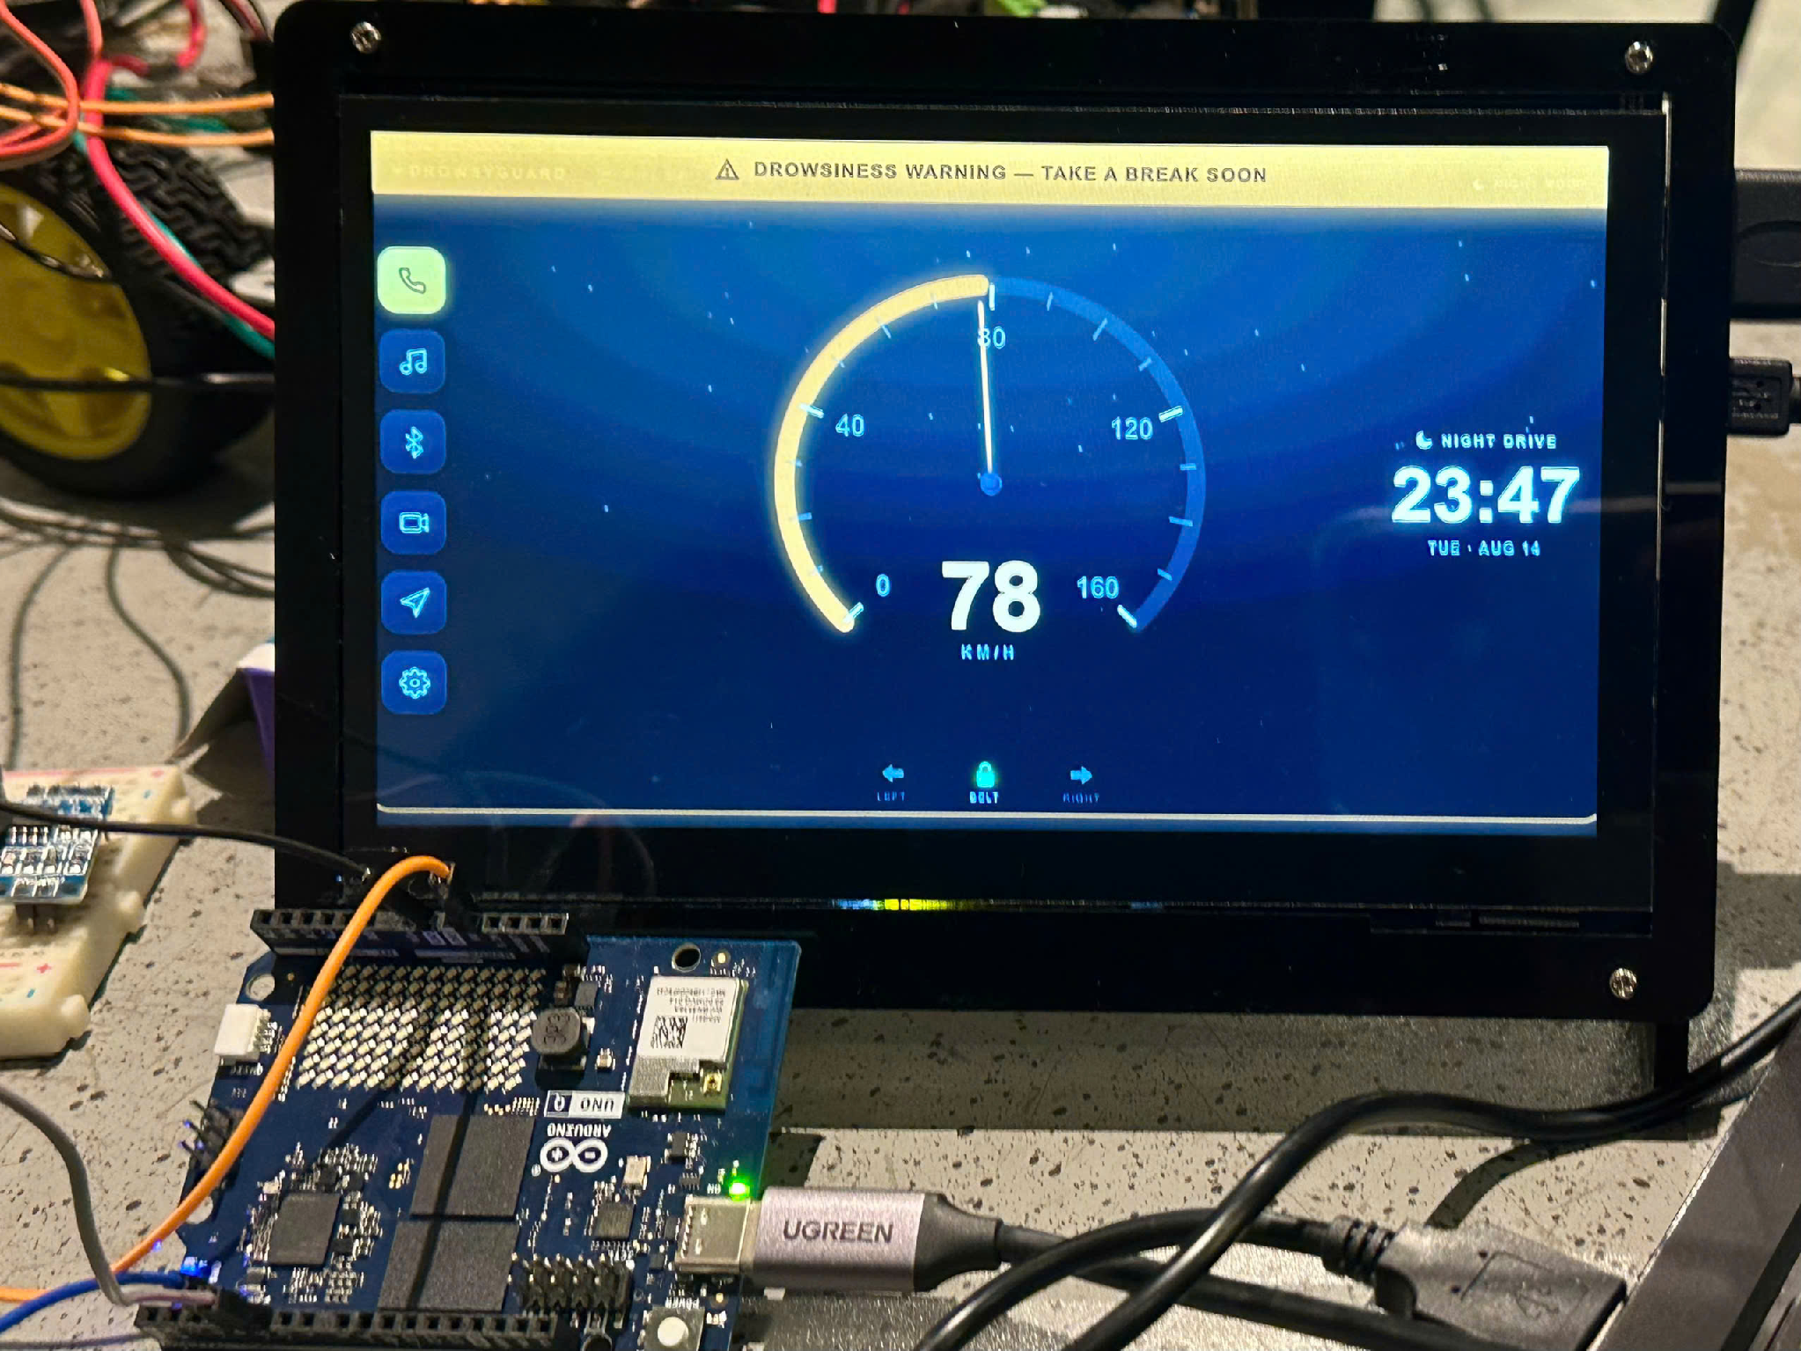
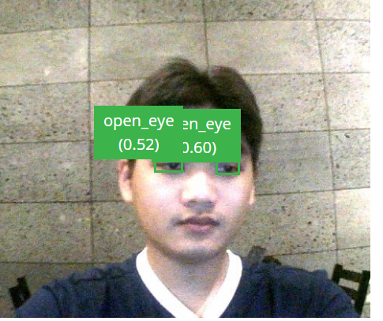
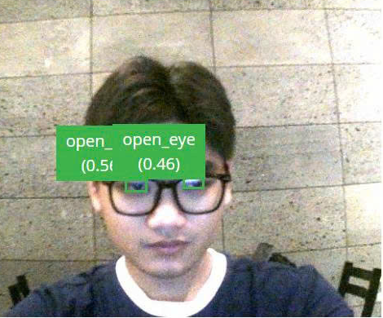
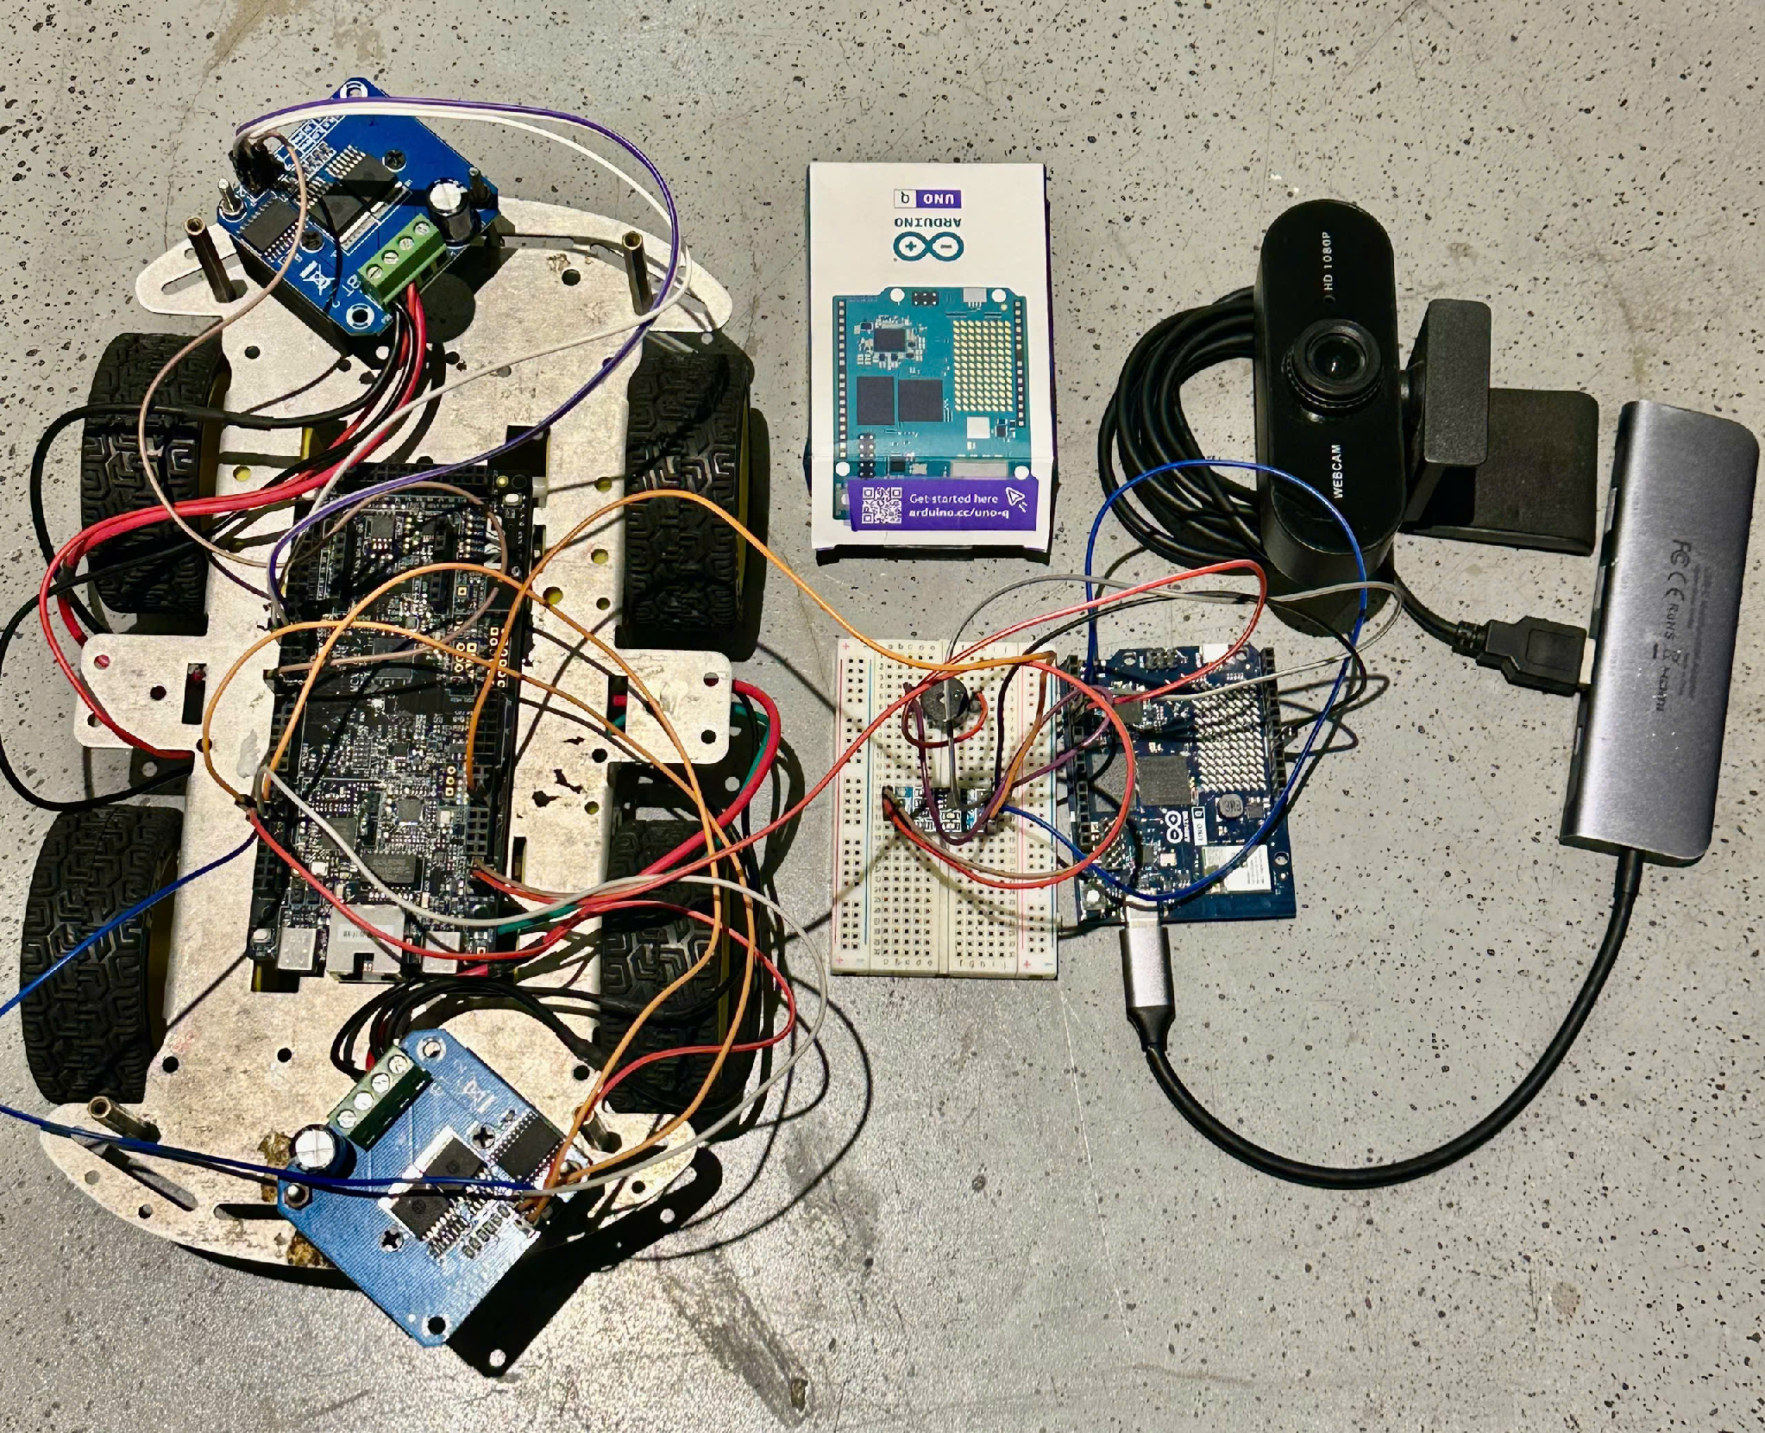
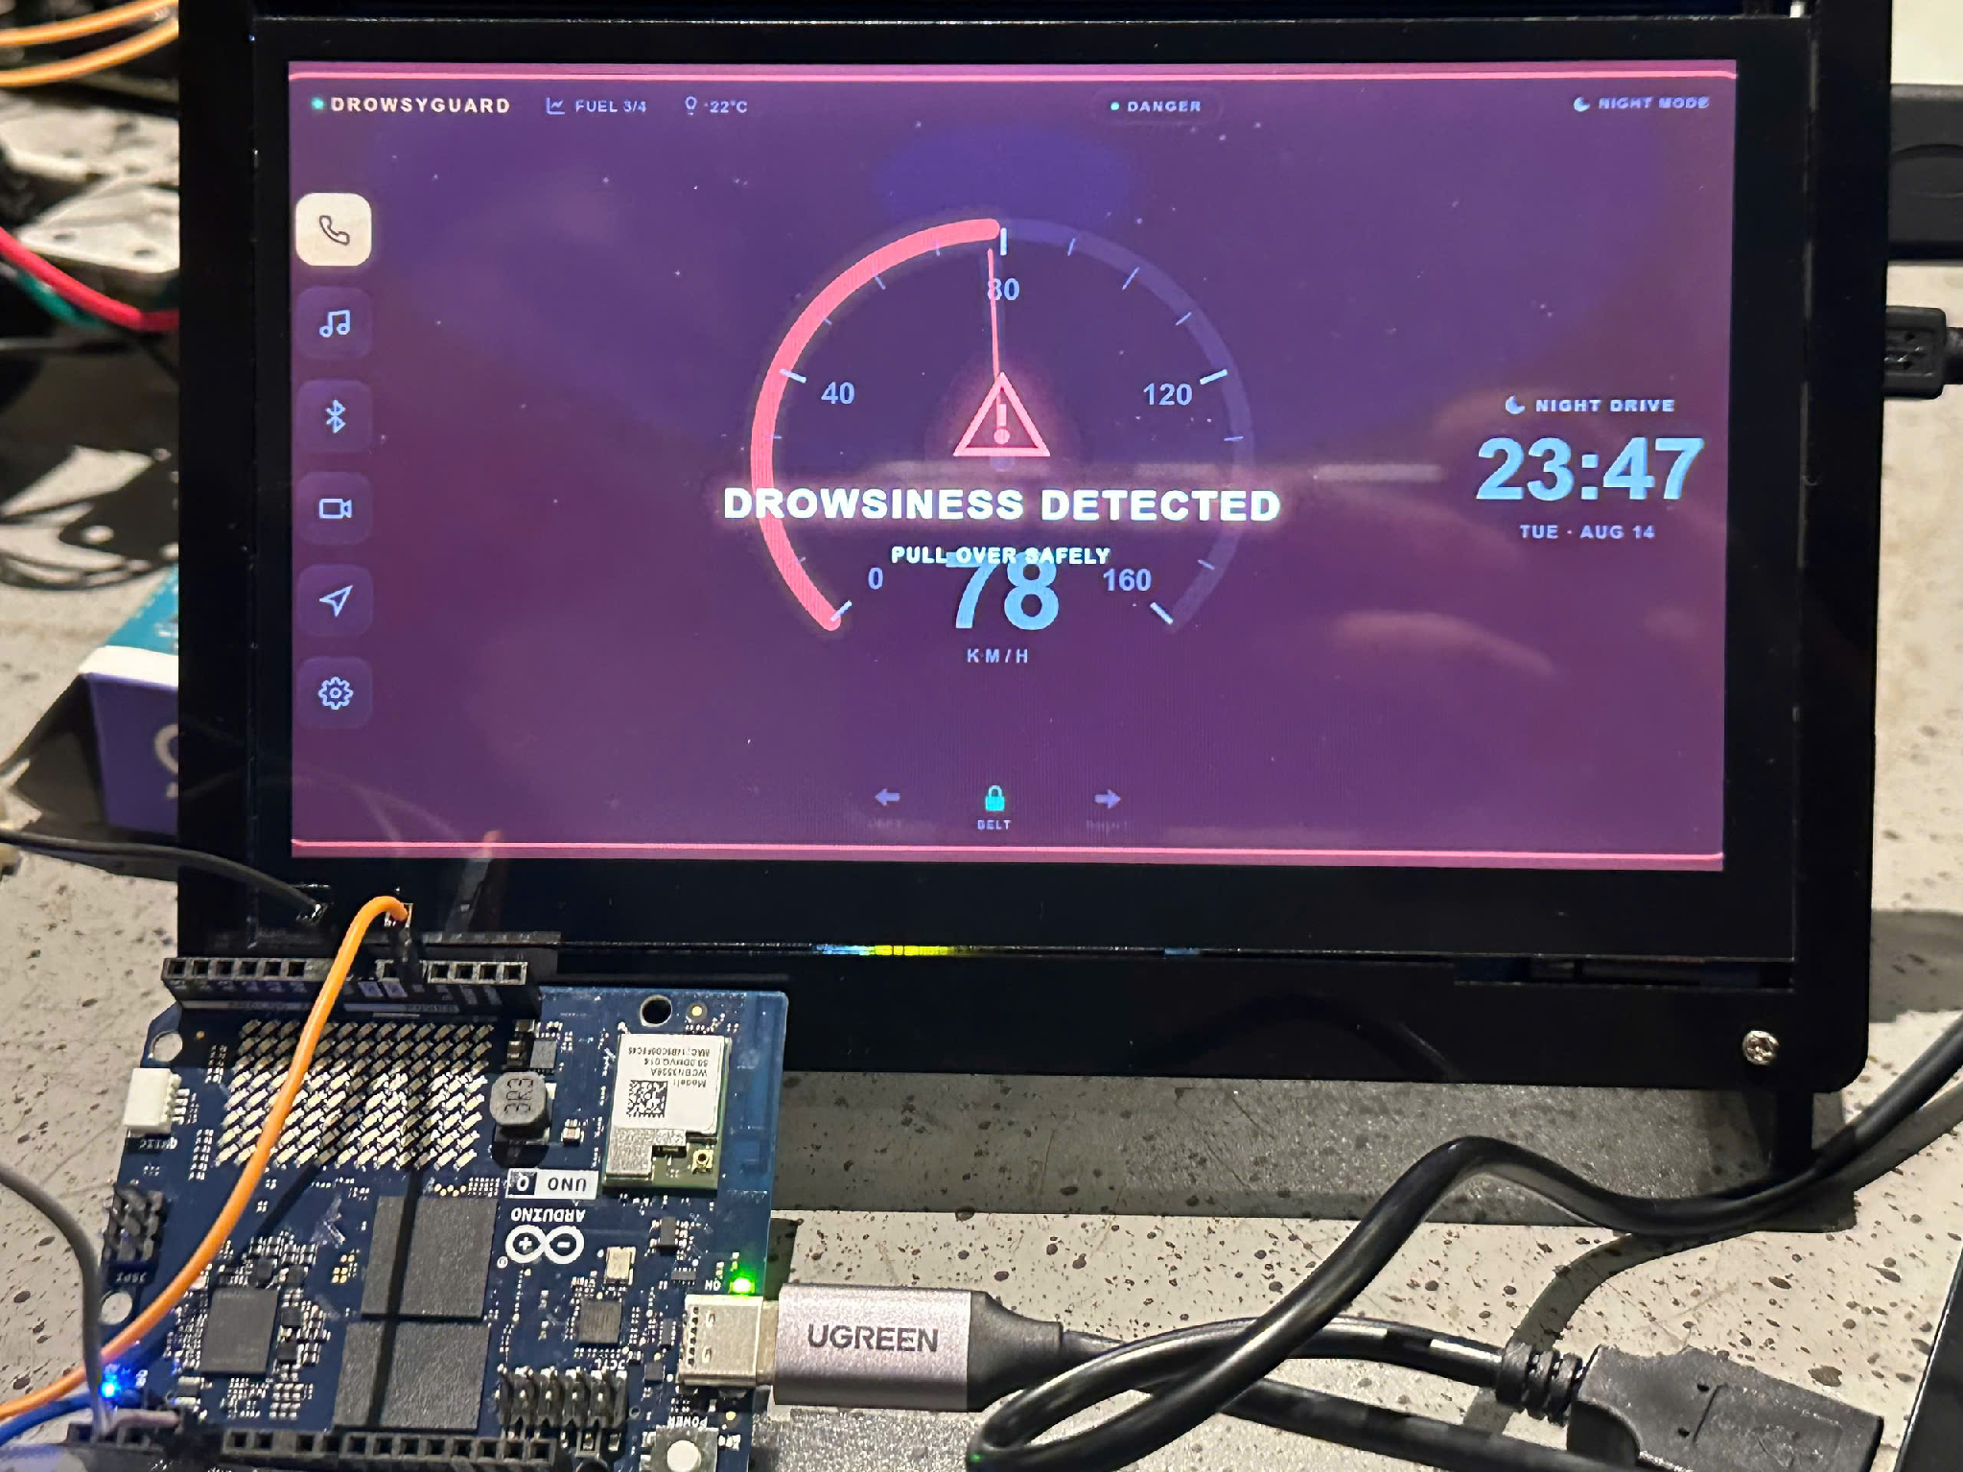
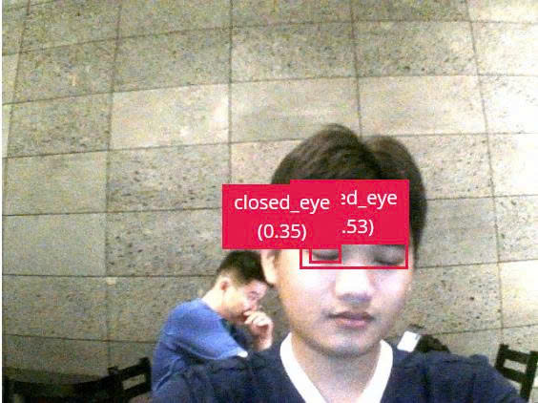
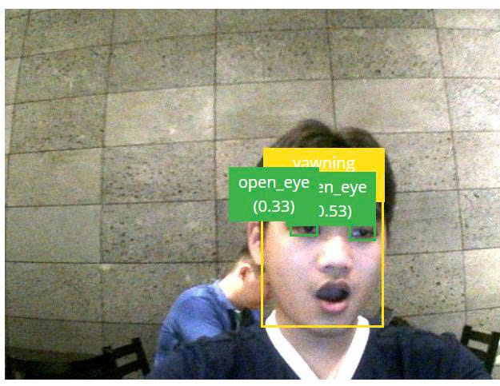
DrowsyGuard
Qualcomm Future Makers — Hack The Challenge 2026
Team ML_IoT_Love50
ARDUINO UNO Q · QRB2210 · DEBIAN LINUX
On-device driver drowsiness detection with vehicle-side intervention
Ho Chi Minh City University of Technology - Vietnam National University
MODEL: YOLOX-NANO
PROPOSAL
SYSTEM ARCHITECTURE
- Drowsy driving is detected on the driver's face and corrected in the vehicle.
- DrowsyGuard splits those two jobs across one CAN bus.
- The DMS (Arduino UNO Q + driver-facing camera) runs a YOLOX detector on-device and fuses three signs of drowsiness into a four-level alert ladder.
- The VCS (NXP FRDM-MCXN947, four-motor scale vehicle) reads only that level: caps speed, escalates alerts, and safe-stops at the top level.
PRODUCT FEATURES / VALUES
≤ 1000 ms
Photon to actuator, 95th percentile
≥ 5 FPS
Sustained inference on-device
3 domains
Distraction, yawning, eye closure
0 bytes
Image data ever leaving the node
2.0 s
Safe-stop ramp, ± 0.1 s
≤ 1 / hour
False alarms on an awake driver
DOWNSINESS LEVEL 1 - SOFT WARNING
HARDWARE COMPONENTS
DMS node
Arduino UNO Q — Dragonwing QRB2210 + STM32U585
Camera
Driver-facing RGB + IR illuminator, 5 – 50 000 lux
VCS node
NXP FRDM-MCXN947 — FlexCAN, PWM, windowed watchdog
Traction
4× TT gear motor 1:48, differential drive
Alerts
Buzzer ≤ 85 dB(A), RGB LED, vibration motor, hazard lamps
Bus
2× CAN transceiver, twisted pair, 500 kbit/s
Safety
Physical e-stop, independent of firmware
DETECTION DOMAINS
D1 Distraction
Head yaw > 30° or pitch-down > 20°, sustained ≥ 2 s
L1 — EYES ON THE ROAD
D2 Yawning
Mouth-open episodes ≥ 1.5 s, 2+ in a 120 s window
D3 Eye closure
Continuous closure at 800 / 1500 / 3000 ms → L1 / L2 / L3
ALERT LADDER & VEHICLE RESPONSE
L0
Silent, green LED, 100 % speed
L1
Soft pulse alert, amber LED, 80 % speed cap
L2
Continuous tone, vibration, fan, 50 % speed cap
DOWNSINESS LEVEL 2 - WARNING
L3
Alternating alarm, safe stop in 2.0 s, hazards latched
VERIFICATION TARGETS
Off-road detection, held-out corpus
TPR ≥ 0.90
Yawn detection, held-out corpuzs
F1 ≥ 0.85z
False alarms, awake-driver baseline
≤ 1 / h
Safe-stop ramp from L3 receipt
2.0 ± 0.1 s
NEXT DEVELOPMENT DIRECTION
STEP 1
Bring up hardware and re-measure every budget on this sheet against real timing
STEP 2
Re-tune the three detection thresholds on the team's own annotated driver corpus
STEP 3
Run the full nine-area test plan on hardware and move every DESIGNED figure to VERIFIED
STEP 4
Extend from a scale-vehicle simulator toward a real-vehicle CAN integration path
DrowsyGuard is a research demonstrator. The scale vehicle is a simulator. No claim of ISO 26262 / ASIL compliance is made.
DEMO MODEL
PRODUCT HARDWARE PHOTO
DOWNSINESS LEVEL 3 - HIGH ALERT

